Slide 1

The Three Environments of the Canadian Armed Forces
Canadian Army
Royal Canadian Navy
Royal Canadian Air Force

Slide 2
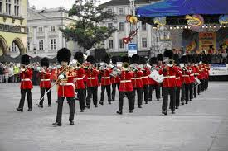
Interacting with Military Forces Members
Be respectful, polite and attentive
Salutes are only exchanged between service members in uniform
If you know the rank of a service member, address them as such, otherwise just address them in a respectful manner (i.e. Sir or Ma’am)
Avoid conversations about their service unless they raise it
Avoid conversations about politics, especially regarding military missions
Thank them for their service

Slide 3

For more information go to forces.gc.ca

