Slide 1
Venue RECCE: Invictus Games Village at the Sheraton (SHR)
September 10, 2017

Slide 2
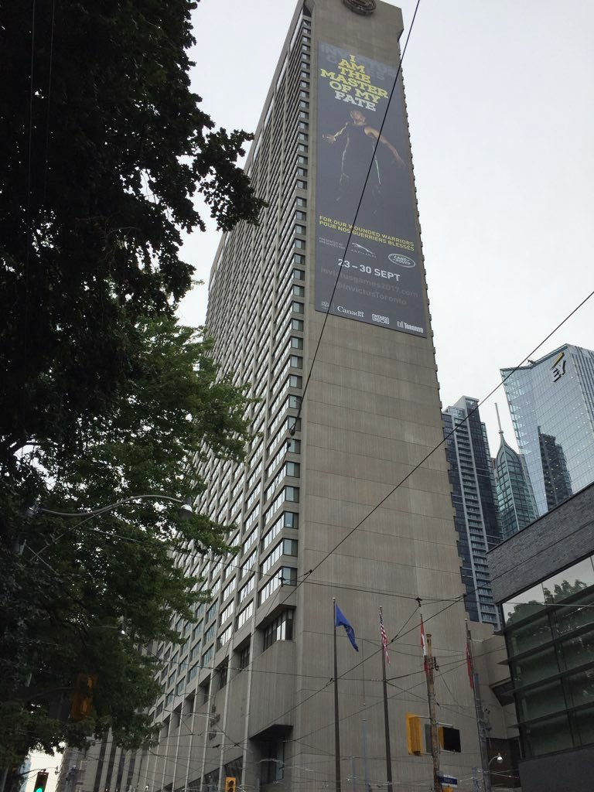
WELCOME TO THE VILLAGE
Introduction
  Jim Stewart, Village General Manager
  Jordyn Bayly-Jones, Accommodations Manager
  Erika Pugsley, Operations Coordinator
  Kristina Snjaric, Village Operations Associate
  Madeleine Davidson, Nancy Cunningham & Donald Snyder,
  Workforce Supervisors

Slide 3


ICEBREAKER
Say “Hello” to 4 people around you and share the following:
What languages do you speak?
I volunteered for the Invictus Games because...
NAME
+ F.A.
+
+
3
Minutes!

Slide 4



VOLUNTEER JOURNEY
Congratulations!
At the end of this journey you will be Games Ready!
Application
Interview
Offer and Acceptance
Games RECCE Training
Roster Published
Volunteer Summits
Venue RECCE Training

Slide 5

AGENDA
Village Orientation
Invictus Games Team Behaviours
About the Village
Key Customers and Services
Volunteers in the Village
Village Safety Procedures
Village Tour

Slide 6


BEFORE WE GET STARTED
Recce 1½ hour, Tour 1hour
Washrooms are at the end of the hall, close to the escalators
Devices should be silenced
Safety
Hold Questions for the tour

Slide 7
YOUR VILLAGE RESOURCES
Games-time Pocket Guide | Distributed with your uniform and accreditation
Village Map | Distributed today, use this during the tour and store in your pocket guide at Games Time!
Radio Fleet Map and Contacts | Provided to you today, attach this to your accreditation
Your supervisor is your best resource! | If you need help, ask your Supervisor!

Slide 8
Invictus Games 2017 Team Behaviours
remember: I am the Master of My Fate, Captain of My Soul
SAME
TEAM
SAY IT,
DO IT
TELL IT
LIKE IT IS
TAKE THE HIGH ROAD
MAKE IT
FUN!
COLLABORATE
CHALLENGE CONSTRUCTIVELY
HAVE EACH OTHER’S BACKS
CROSS THE FINISH LINE TOGETHER
BE ACCOUNTABLE
TRUST EACH OTHER
LEARN AND ADAPT
SET REALISTIC TIMELINES
ACT WITH HONESTY AND INTEGRITY
BE TRANSPARENT
BE SENSITIVE TO THE CUES
BE THE BEST YOU CAN BE EVERY DAY
BE RESPECTFUL AND INCLUSIVE
ROLE MODEL THE BEHAVIOURS
LAUGH OUT LOUD!
SURPRISE AND DELIGHT
BE PRESENT

Slide 9
VILLAGE
AMENTITIES AND ACTIVITES

Slide 10
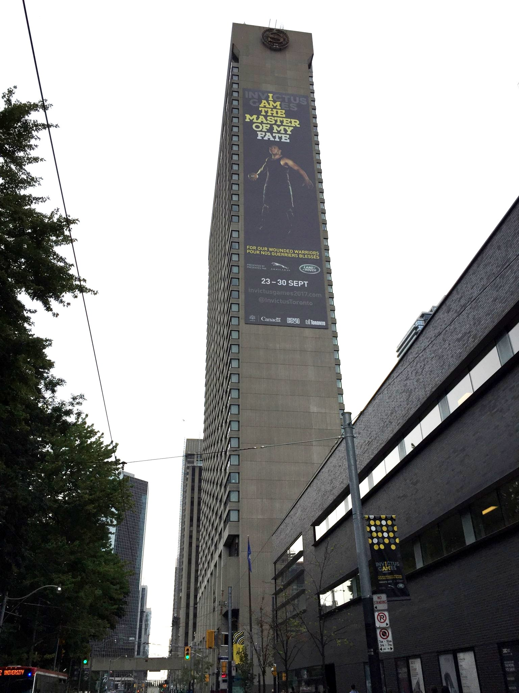
VILLAGE DEFINED
  Operational from Sept 21 – Oct 1, the Sheraton Centre Toronto Hotel will serve as our Invictus Games Village warmly welcoming Competitors, Team Officials and Friends & Family to Toronto!
  Why is it called a “Village”?
  Not just a hotel – it is an experience!
  A place to relax, rest – “home away from home”
  Daily entertainment
  A hub for activities
  Creating lasting memories

Slide 11
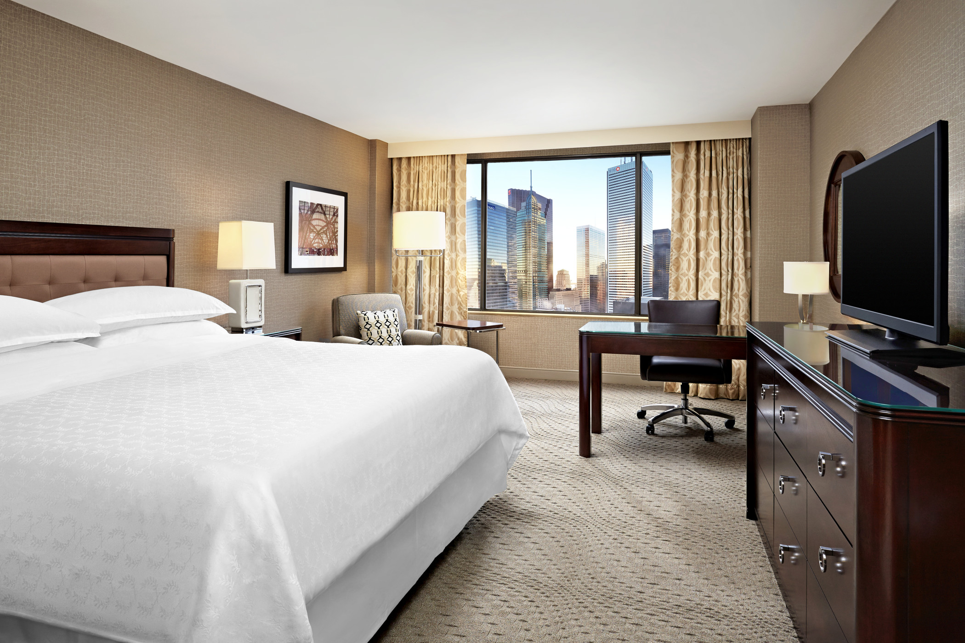
WHO SLEEPS IN THE VILLAGE?
558 Competitors
1106 Friends & Family
281 Team Staff
1945 TOTAL GUESTS
1345 guest rooms at peak time!

Slide 12
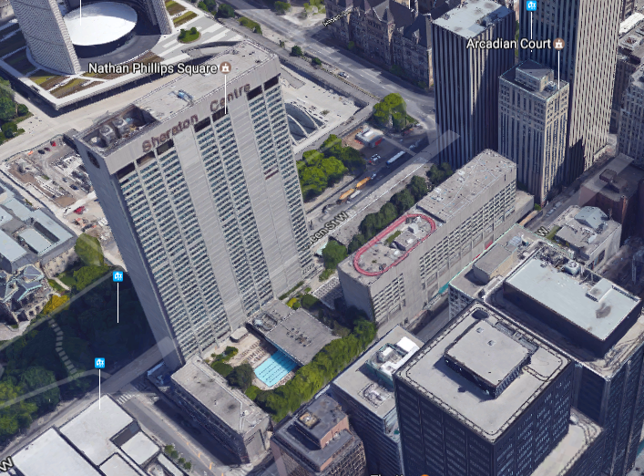
WHERE DO THEY SLEEP?
Competitors
& Team
Managers
Gaps filled with
F&F
F&F
QUEEN TOWER
RICHMOND

Slide 13
WHO VISITS THE VILLAGE
Competitors/ Team Officials
Friends & Family
Workforce
Media
General Public
Games Guests
Sponsors & Partners

Slide 14

VILLAGE VOLUNTEERS:
Invictus Games Toronto 2017 workforce members: 513
  Volunteers: 406
  Contractors & Staff: 107
  One team working together to
  deliver an extraordinary world-class event!

Slide 15
VOLUNTEER HELP DESKS
Volunteer Desk | Services Provided
Invictus Games Village Help Desk | General Invictus info, Meal hall hours of operations, lost and found, lost persons, Day passes, general Toronto information, and meeting space booking.
Friends & Family Help Desk | Information specific to the friends and family program including external events and general information.
Sport info desk | Training and competition schedule, including results.
Transport help desk | Bus schedule to training and competition venues, plus arrival and departure information. Assistance for mishandled baggage.
Logistics Help desk | Sport equipment movement to competition venues, transport of nation’s freight, master delivery scheduling and logistics issue resolution.

Slide 16
VILLAGE TIMELINE
SEP 18
BUMP IN
PRE ARRIVALS
SEP 20
BUMP IN
SEP 21-22
BUMP IN
OFFICIAL OPEN
BULK ARRIVALS
SEP 23
ARRIVALS
OPENING CEREMONY
SEP 24-29
BUMP IN
DAILY OPERATION
SEP 30
CLOSING CEREMONY
VILLAGE RECEPTION
OCT 1
FAREWELL BREAKFAST
BULK DEPARTURE
OFFICIAL CLOSE

Slide 17
VILLAGE
Key FUNCTIONS AND services

Slide 18






WHO AND WHAT IS IN THE VILLAGE?
The Village is very different from a sports venue:
Will house over 16 Functional Areas
Main accommodations for Competitors and Friends & Family
Transportation Hub
Media Central
Entertainment
AND MUCH MORE…

Slide 19
ACCOMMODATION FA (ACM)
Basic function (Sept. 18 – Oct. 1)
The Accommodation FA serves as venue management for the Village, operating the Village Operations Centre (VOC), controls meals for clients, monitors access to zones, and provides additional amenities and activities for our guests.
WHAT YOU NEED TO KNOW…
The ACM FA is here to ensure the safety of our guests but also to ensure they have FUN and create LASTING MEMORIES!

Slide 20

MEAL HALLS (Operated by ACM)
Competitor Meal Hall
Breakfast and Dinner for Competitors and Team Management
Friends & Family Meal Hall
Breakfast for Friends & Family and Invictus Games Foundation (IGF)
WHAT YOU NEED TO KNOW…
Unless specifically instructed from the Village General Manager, no volunteer should ever eat in the Competitor or F&F meal Hall.
Competitors do not eat with family/friends and vice-versa with the exception of the last day for the Farewell Breakfast on Oct 1

Slide 21
ENTERTAINMENT LOUNGE (Operated by ACM)
Basic Function (Sept. 21 – Oct. 1)
Space open to all competitors, team officials, friends & family. Activities throughout the Games including programming for adults and for children.
WHAT YOU NEED TO KNOW…
The lounge is open all day with activities, games and live entertainment throughout the afternoon and evening.
Coffee and tea are available for competitors and friends & family at all times.

Slide 22
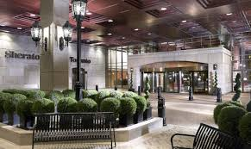
TRANSPORT (TRN)
Basic function (Sept. 21-Oct. 1)
Provide transport for most Invictus clients to/from airport, competition venues and opening/closing ceremonies. You can find transport outside the hotel or at the Transport Help Desk inside the lobby.
WHAT YOU NEED TO KNOW…
Buses are large, have huge ‘blind-spots’. Never stand directly behind them and always think SAFETY around all vehicles!

Slide 23
WHO USES TRANSPORT AT THE VILLAGE?
“T” Bus service at the Village for Competitors/Team Officials, Friends & Family, Technical Officials, Media.
      Including 108 competitors/team officials and 6 Friends & Family that are wheelchair users
  “T2” Fleet Car Service for select Games Clients
  Parking at the Village is limited to only operational vehicles with proper VAPPS.
  Clients MUST have their Accreditation to access any transport services.
Workforce provided with Presto cards

Slide 24
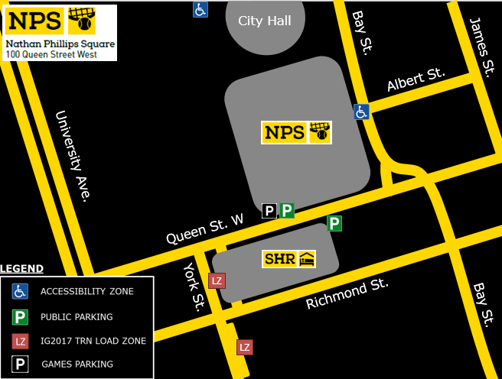
Elizabeth St

Slide 25
TECHNOLOGY (TEC)
Basic function (Sept. 19 – Oct. 1)
To provide technical support to all functional areas as it relates to computers, printers, mobile phones and radios.
WHAT YOU NEED TO KNOW…
Free WiFi is provided by the hotel in all public areas!
Most items are shared among each functional area (phones, radios, etc.) - Be sure to sign them in and put them in the correct charger at the end of your shift.

Slide 26
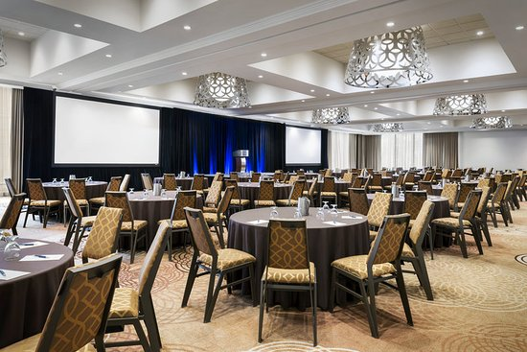
LOGISTICS (LOG)
Basic function (Sept. 18 – Oct. 1)
Deliver and set up select Furniture, Fixtures & Equipment. Movement of excess baggage to/from airport to Village on arrival/departure days. Movement of sports equipment to venues and storage of sporting equipment.
WHAT YOU NEED TO KNOW…
Can be found primarily in loading dock area or VOC.
Operates at LOG Help desk in Lobby

Slide 27
ACCREDITATION CENTRE (ACR)
Basic function (Sept. 21-29)
The ACR FA Operates the ACR centre on concourse level, distributes accreditation and assists with any accreditation related issues.
WHAT YOU NEED TO KNOW…
Accreditation is like a passport - it determines where you can go and what you are entitled to.
The Sheraton Staff will not have Accreditation. They must be in uniform with a name tag to be able to move around the Village.
The ACR centre will be very busy for the first 3 days of operations.

Slide 28
MEDICAL CLINIC (MED)
Basic function (Sep. 21 – Oct. 1)
Provide Medical Services to competitors, team officials, friends and family, and volunteers
WHAT YOU NEED TO KNOW…
Located on the Lower Concourse. Operational hours are 07:00-22:00.
After hours urgent medical care – contact the front desk to be connected with the overnight doctor (onsite).

Slide 29
MEDIA OPERATIONS (PRS)
Basic function (Sep. 22-30)
To serve the needs of the accredited media (power, internet, and access to competitors), and operate Media Central on the 2nd floor.
WHAT YOU NEED TO KNOW…
Direct all media enquiries to Media Central.
Media access to the Village is restricted to certain levels.

Slide 30
SPORT (SPT)
Basic Function (Sept. 21 – Oct. 1)
Operate sport training centre and Nation storage cage facility on lower concourse level.
Categorization and Indoor Rowing Erg Fittings
WHAT YOU NEED TO KNOW…
Operate Sport Info Desk in the lobby
Manage competitor training area
Assist with Categorization administration
Assist with Nation sport equipment movements
Manage set-up for sport Technical Meetings

Slide 31
NATION RELATIONS
Basic function (Sept. 21 to Oct. 1)
17 volunteer Nation Liaison Officers (NLO) responsible for the Visiting Nations from arrival until departure. They travel with their assigned team throughout the city. Act as a contact person for the Nation and are there resolve issues for the team.
WHAT YOU NEED TO KNOW…
If you have any questions or looking for a particular person from a Nations’ team, NLO can assist you with finding the correct person and can provide assistance with language barriers.

Slide 32
FRIENDS & FAMILY (F&F)
Basic function (Sept. 21 – Oct. 1)
Coordinate the Friends & Family program in the Village and organize external trips for this group. They are the main communication to the F&F Nation Liaisons (who represent each nation’s F&F).
WHAT YOU NEED TO KNOW…
Each Competitor is entitled to bring up to 2 Friends & Family members at no charge. Some competitors chose to bring more members and pay to do so.
There will be a Friends & Family Help Desk in the Lobby

Slide 33
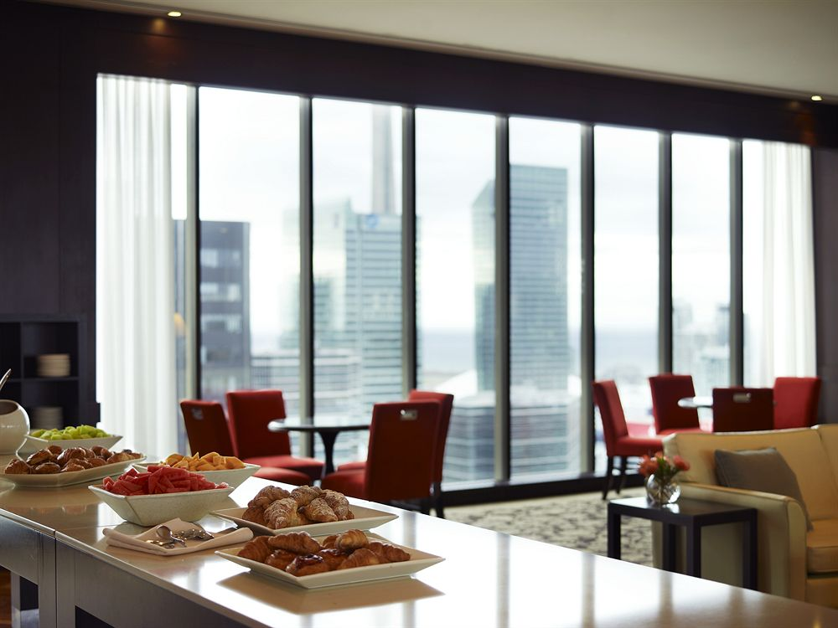
HOSPITALITY (HOS)
Basic function (Sept. 21 – Oct. 1)
Responsible for keeping all client groups well fed and hydrated. Ensure all meals are on time and in a positive, clean and safe environment.
WHAT YOU NEED TO KNOW…
F&F & Competitors receive Gift Cards AND vouchers. F&F will redeem their lunch voucher at Quinn’s Restaurant, attached to the SHR.
  Quinn’s has an accessible route through the hotel lobby, on the east sides
  Hours of operation are 8am-2pm
  Lunch is a grab & go boxed meal

Slide 34
INVICTUS HOUSE (SPN)
Basic Function (Sept. 24-30)
Invictus House is a relaxing space for competitors, team managers, and games guests to meet and mingle. Located on the 2nd floor. Will have a bar and light snacks.
WHAT YOU NEED TO KNOW…
Sponsorship volunteers will be roaming throughout the Village. helping our sponsors onsite (Invictus House, commercial rights, etc).
F&F do not have access to Invictus House.

Slide 35
MULTI FAITH CENTRE
Basic Function (Sept. 21 – Sept. 30)
The Multi-Faith Centre (MFC) provides a place for worship and meditation for all faiths. The Centre provides Chaplaincy services for all Village guests and volunteers.
WHAT YOU NEED TO KNOW…
For all faith based or general counselling services/needs/questions within the Village, the Chaplains are there to serve in the MFC on the lower concourse level.

Slide 36
MERCHANDISE KIOSK (SPN)
Basic Function (Sept. 21 – Oct. 1)
Located in the center of the hotel Lobby. Selling branded items to everyone, including the General Public. Oversight by Sponsorship leads and volunteers.
WHAT YOU NEED TO KNOW…
Although there are some very cool items for purchase, just a reminder that you are only permitted to wear uniform items while on duty.

Slide 37
Invictus Games Toronto 2017 Veterans Career Summit, brought to you by Barrick
When: September 28th & 29th from 10:00am to 5:00pm
Where: Osgoode Ballroom
Offers potential national and international job seekers looking to transition to civilian life an opportunity to connect with potential employers
Guests (including our competitors and F&F) will be able to access career advising, catch keynote speakers on relevant topics and make use of an area where interviews can take place and job offers can be made.

Slide 38
MOC, TROC, POC, VOC, TOC
MOC – Main Operations Centre
TROC – Transportation Operations Centre
VOC – Village Operations Centre
VCC – Village Communication Centre
POC – Protocol Operations Centre
TOC – Technology Operations Centre
WHAT YOU NEED TO KNOW…
The MOC is the Operations Hub for the Entire Games, access to this space is restricted.
The VOC is the Operations Hub for the Village, and is accessible to all volunteers.
Located in the MOC
Located in the VOC

Slide 39
WHERE IS EVERYTHING?
There are 4 floors with amenities in the Village
  2nd Floor
  Ground Floor/Lobby
  Concourse
  Lower Concourse
If someone’s accreditation does not specify the area they are trying to access, they are not permitted inside the space.
On your tour later today you will get to see each floor and everything they have to offer!

Slide 40
VILLAGE
policies & procedures

Slide 41
ACCESSIBLE AREAS AND SERVICES
Instructions:
Examples are provided in { } .
Make sure these are updated to reflect your specific venue
Accessible Entry/Exit | All entries/exits to the Village are wheelchair accessible except the doors off Richmond
Accessible Toilets | Accessible toilets are available including unisex toilets on the lower concourse, concourse and 2nd floor 16 accessible suites with accessible toilets in Queen tower are shared by all competitors
Other | Dog relief area located on the 2nd floor in the Waterfall Garden Area
For more information:
The information booth will have access to all accessibility information specific to the venue

Slide 42

Smoking Policy
Smoking is ONLY permitted in designated smoking areas OUTSIDE the hotel.
PROCEDURE FOR VOLUNTEERS:
You see someone smoking in an interior space report to the VOC Supervisor – if you feel safe doing do, collect the accreditation details (name, country, type of guest).
INDOORS

Slide 43

Lost and Found at SHR
We will use the Hotel’s existing lost and found system.
PROCEDURE FOR VOLUNTEERS
A guest or volunteer finds an item in the hotel:
  Drop the item off at the Village help desk or at the hotel front desk. If you drop it off at the Village Help Desk, the help desk volunteer will record a description as a notice of receipt and transfer.
  In the case of lost/found accreditation, visit the ACR centre.

Slide 44

Lost Key
LOST KEY TO GUEST SUITE – Guest must obtain a replacement from the Front Desk of the Hotel. Identification must be shown in order to obtain a new key.
LOST KEY TO A FUNCTION SPACE - Workforce that lose keys need to report to the VGM.

Slide 45

Access to Guest Rooms
No member of the Invictus Games Workforce are permitted to enter guest rooms.
If a situation requires a member of the Invictus Games Workforce to access a guest floor, Supervisory approval must be obtained.

Slide 46

Missing Child
If a missing child is reported to you, immediately contact the ACM Supervisor by phone or by radio. They will notify Invictus Security who will notify Hotel Security.
If necessary, take the person reporting the missing child to a quiet area but do not leave them alone.
Document any questions you ask so they do not need to be asked twice.
SEC lead takes over with support from the ACM supervisor.

Slide 47

Consumption of Alcohol
Consumption of Alcohol is not permitted in any public space of the Village including the Meal Halls or the Entertainment Centre.
If our guests make purchases from the LCBO, they may consume Alcohol in their guest rooms.
Alcohol may be purchased in the onsite restaurants and bars.
Invictus House and other select events/function may serve Alcohol and will have a license to do so.

Slide 48
VOLUNTEERS AT THE VILLAGE

Slide 49

GETTING TO THE VILLAGE
TTC - Subway | Osgoode Station Queen Station
TTC - Bus/Street Car | 501/502/301 East and West Bound Bus/Street Car on Queen St – York St Stop
Parking | There is no parking at the Village, closest parking at NPS Green P (at a fee)
GO Train | Union Station (15-20 min walk)
TIP: Allow for extra travel time to get from transit to Workforce Check-In.

Slide 50
WHAT SHOULD I BRING?
Your Accreditation
IG2017 Uniform (with your name in it)
IG2017 Games-time Pocket Guide (with your name in it)
Water bottle (with your name on it)
x No prohibited and/or restricted items
x No personal belongings other than what can keep on your person – leave all valuables at home where they will be safe.

Slide 51
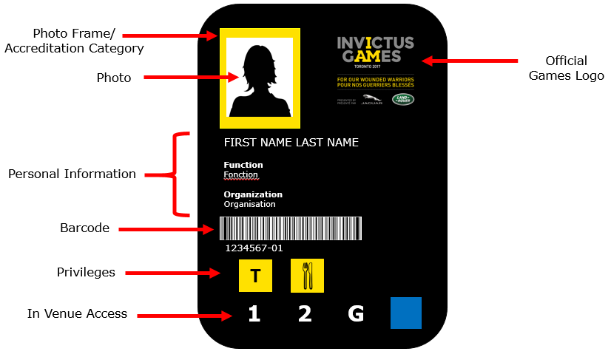
ACCREDITATION
Wear your accreditation at all times
Hang your accreditation card around your neck with the front side visible (see image)
Don’t use your accreditation when you are off duty
Don’t loan your accreditation out to anyone
Accreditation is not a free ticket.

Slide 52
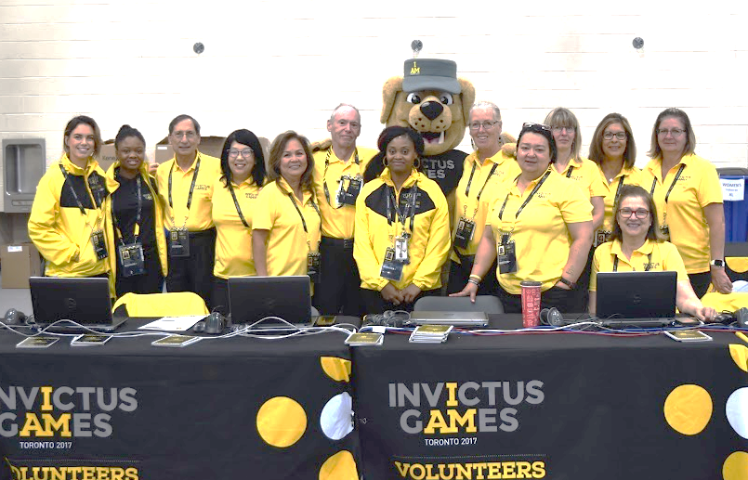
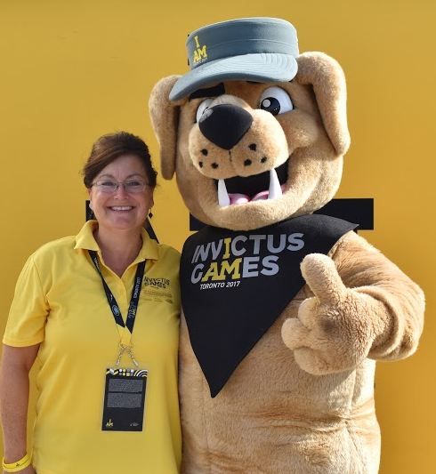
INVICTUS GAMES TORONTO 2017 UNIFORM
Wear full Games uniform – Sept 20th onwards
Read wear and care guidelines
Do:
    write your name in all components
    keep clean and presentable
    hide evident logos or trademarks on non uniform pieces.
    protect your uniform from damage, loss or theft

Slide 53
WORKFORCE CHECK-IN
Workforce Check-In (2nd Floor – Dominion Ballroom) is the first place you need to go when you arrive
Check in at least 15 minutes but no more than 45 minutes before your shift.
At Workforce Check-In:
    Your Accreditation will be scanned to confirm you have arrived for your shift
    You will receive your meal voucher & any shift gifts.
    You will receive any other necessary information
Once checked in, report to your supervisor at your function’s designated meeting area/location. You FA Supervisor is your#1 contact.

Slide 54
MEALS AND BREAKS
Meal Gift Cards issued based on shift duration
(1 voucher for a 6 hour shift; 2 vouchers for 10+ hours)
You can use your gift card to purchase food outside the hotel.
You can eat your meal outside the hotel or bring it back to Workforce Break. Remember no storage nor refrigeration will be available.
Return from your break promptly and check-in with your supervisor to inform you are back from break.
Coffee and tea is provided in workforce break area for all volunteers
Workforce Break Area | 2nd Floor Dominion Ballroom

Slide 55
WORKFORCE KEY CODE OF CONDUCT POLICIES
Do Not… | Do…
Speak to the media without prior consent. Refer all media inquiries to the Venue Press Manager Smoke in public view (only in designated areas and during breaks) Consume alcohol or use illegal drugs Photograph competitors/Games Guests or ask them for autographs Socialize on your cell phone or personal devices during your shift Use obscenities, offensive language, harass or treat others in a violent, discriminatory or abusive manner | Comply with the Invictus Games Toronto 2017 Volunteer Code of Conduct Act according to the established policies and procedures Report any instances regarding workforce safety or discrimination to your supervisor Treat information concerning the Games in a strictly confidential manner Provide timely notice to your supervisor if you will be late or cannot make your shift Have FUN!

Slide 56
DURING AND AFTER YOUR SHIFT
Wash your hands regularly
Adequate sun protection
Wear appropriate footwear
Stay hydrated and nourished
When your shift is complete, you do not have to check out, but must notify your Supervisor
Ensure you take all your belongings

Slide 57
Village SAFETY PROCEDURES

Slide 58

GENERAL SAFETY MESSAGE
One of our top priorities is ensuring the safety and well-being of all volunteers.
Always keep in mind that you have the:
  Right to Know
  Right to Refuse
  Right to Participate

Slide 59
SAFETY RESOURCES
Your supervisor | Know who your Supervisor is
Radio Fleet Map and Contacts | Refer to this document to obtain essential information when you need it most
Village Operations Centre (VOC) | Acts as the “venue incident command centre” in the event of a hazard or major incident
Incident Notification Form | Complete this form for all types of incidents and submit to your supervisor or the VOC
On Site Medical Clinic | The Medical Clinic is primarily for Competitors and F&F but will assist volunteers in emergency situations.

Slide 60
RESPONDING TO AN INCIDENT
If something does happen, use this model to decide what action to take
Ask yourself, DOES THIS REQUIRE ACTION?
ACT
Does this situation require anyone to act, or not; can we wait?
If action is required- can YOU act?
ESCALATE
AND/OR is it something you need to escalate to your supervisor/team member or relevant functional area?
Who ELSE needs to know?
Informing is key because it keeps the channel of communication open and you also have the opportunity to verify that you took the right course of action.
INFORM

Slide 61
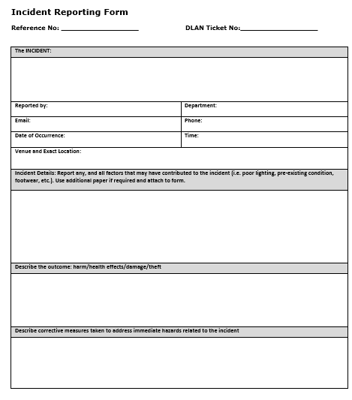
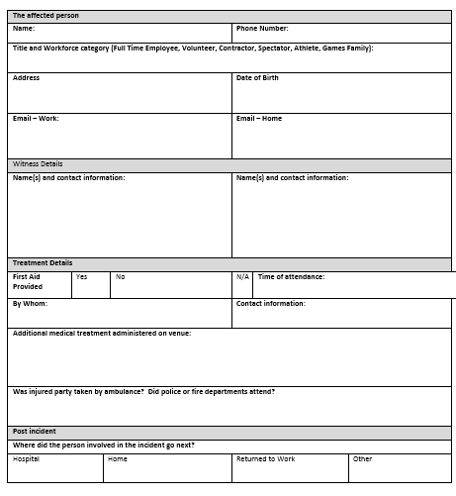
INCIDENTS TO REPORT
Injury
Hazard Identification – Tripping, Slipping, Vehicle, Overheads, Wind, Fire, Weather & Crowd
Smoking Reported in interior space
Property Damage / Loss
Physical altercations
Lost or missing person
When in doubt, fill it out!

Slide 62
TO FILL OUT AN INCIDENT REPORT
Complete an Incident Notification Form for ALL Incidents (available at Workforce Check-in). They must:
Be completed for all incidents
Be completed as soon as possible and be legible
Be detailed (date, time, location, name of person(s) [if provided], nationality, footwear etc.)
Limited to facts and observations (no opinions, hypotheses)
Note if emergency services were requested
Take pictures, if possible, and note if CCTV is present
DELIVER FORMS TO VILLAGE OPERATING CENTRE (VOC)

Slide 63
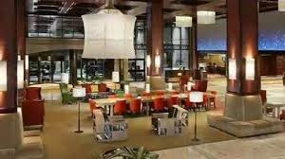
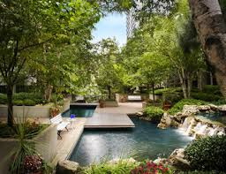
SECURITY & SAFETY AT THE VILLAGE
Every person is responsible for the Security of the Village.
The Hotel is still a public building – always be alert.
During your shifts be aware of the nearest emergency exits.
You will see roaming Police throughout the Village.
Remember… If you SEE something suspicious – SAY something!
Alert your Supervisor or Security

Slide 64
SECURITY – HOW CAN I HELP?
Don’t:
Directly intervene in any suspicious activity.
Don’t attempt to enter areas that you do not have access privileges for
Do:
Know and understand the restricted and prohibited items list.
Be polite and courteous with everyone you meet.
Be aware, be vigilant and report suspicious activity to your supervisor.
Immediately report emergencies to your supervisor or directly to police and security guards.
Examples of suspicious activity:
Abandoned packages or bags.
Someone with wrong, forged or stolen accreditation in unauthorized area.

Slide 65

EMERGENCY FIRST AID AND MEDICAL
In the case of an emergency:
Call 911
Notify the appropriate FA (MED, SEC)
Call Sheraton Security Dispatch by dialing 4977 on any hotel phone, or alert the Front Desk
Inform your supervisor through radio or phone
Medical Clinic Located on Lower Concourse Level
All contact info is attached
to your Accreditation!
Our Games Guests (Competitors, F&F and Team Management) are our TOP priority. In addition, Medical is on site and are able to help all client groups including volunteers and general public in emergencies.

Slide 66
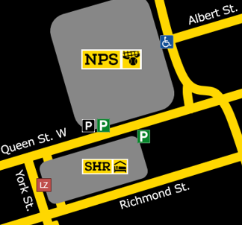
EVACUATION PROCEDURES
If you encounter a fire, pull the fire alarm (if it is safe to do so)
The Sheraton has a 2 stage Alarm. When you hear an alarm, listen and follow instructions on the PA.
Move quickly to the nearest emergency exit, use only the designated fire stairs, do not use internal stairs or elevators.
Proceed to the designated assembly
area at Nathan Phillips Square
At NPS Report in with your Supervisor.

Slide 67
ACCESSIBLE MUSTER POINTS
If a person requires assistance to evacuate, they are to proceed to the following areas (if it is safe to do so):
  Guest rooms - Nearest accessible room
  2nd Floor - Workforce Break Area located in Dominion Ballrooms
  Lower Concourse - Competitor Meal Hall located in Grand Centre Ballroom
The Fire department and the hotel will report to these locations to offer assistance.

Slide 68
ARE YOU READY to see THE VILLAGE?

Slide 69
Thank You!

